Slide 1

What’s new in PDE for Ganymede?
“In PDE we do tooling, but our business is people”
Chris Aniszczyk <zx@code9.com>
Principal Consultant at Code 9
PDE Technical Lead
© 2008 by Chris Aniszczyk; made available under Creative Commons Att. Nc Nd 2.5 license
Eclipse Foundation, Inc.
What’s new for PDE in Ganymede? | © 2008 by Chris Aniszczyk; made available under Creative Commons Att. Nc Nd 2.5
Notes:
Note: Mention that this is focused on plug-in development, not building plug-ins

Slide 2
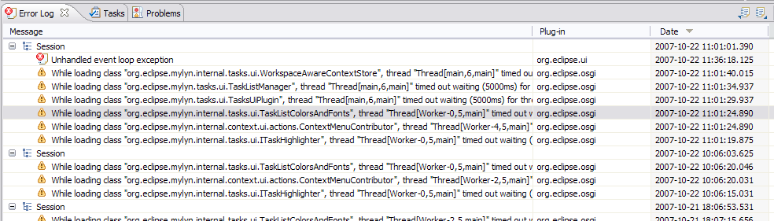
Error Log Enhancements
More than meets the eye…
Group log entries by
  Session
  Plug-in
Eclipse Foundation, Inc.
What’s new for PDE in Ganymede? | © 2008 by Chris Aniszczyk; made available under the EPL v1.0

Slide 3
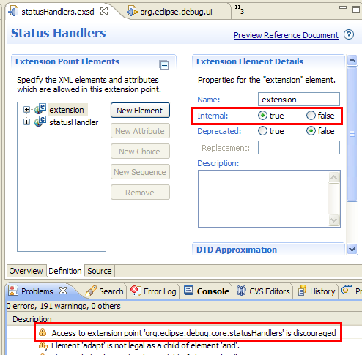
Internal Extension Points
Extension points can be marked as internal now, similar to how you mark packages internal
What’s new for PDE in Ganymede? | © 2008 by Chris Aniszczyk; made available under the EPL v1.0

Slide 4
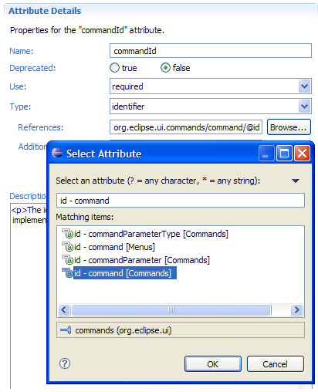
Schema Identifiers
A new type was introduced in extension points: identifier
Identifiers allow you to reference other extensions
e.g., perspective extensions refer to a perspective id that is defined in another extension point
What’s new for PDE in Ganymede? | © 2008 by Chris Aniszczyk; made available under the EPL v1.0

Slide 5
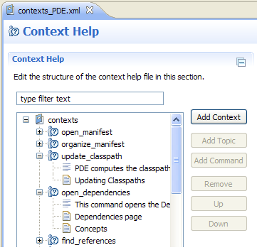
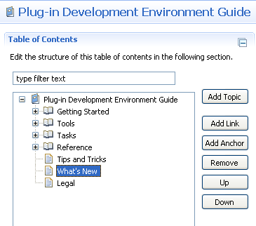
New User Assistance Editors
Table of Contents Editor
Context Help Editor
What’s new for PDE in Ganymede? | © 2008 by Chris Aniszczyk; made available under the EPL v1.0

Slide 6
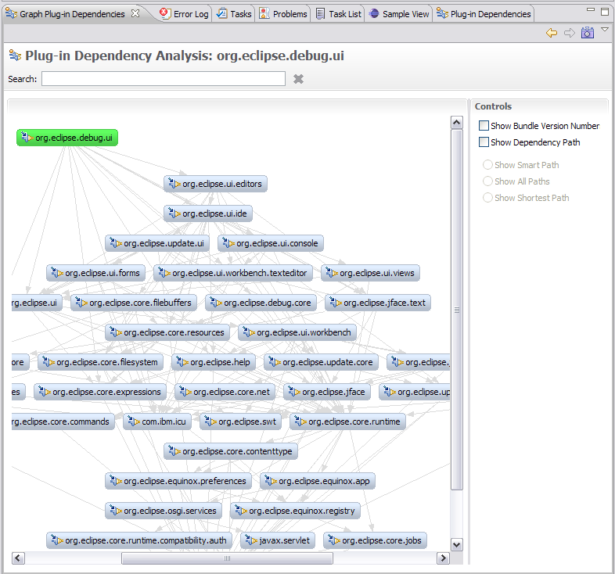
Graph Plug-in Dependencies View (incubator)
PDE Incubator Project
Visualize your dependencies
Pictures are worth a thousand words
* http://www.eclipse.org/pde/incubator/dependency-visualization/
Eclipse Foundation, Inc.
What’s new for PDE in Ganymede? | © 2008 by Chris Aniszczyk; made available under the EPL v1.0

Slide 7
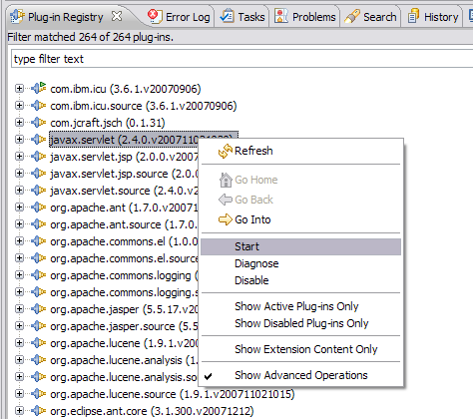
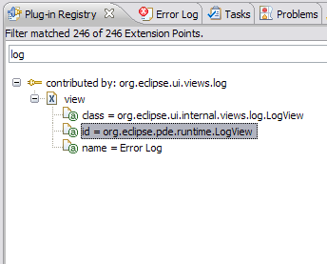
Plug-in Registry View Enhancements
The Plug-in Registry view is your eye into the runtime
Show Advanced Operations
  start/stop bundles
Show Extension Content Only
  quickly browse extensions
Eclipse Foundation, Inc.
What’s new for PDE in Ganymede? | © 2008 by Chris Aniszczyk; made available under the EPL v1.0

Slide 8
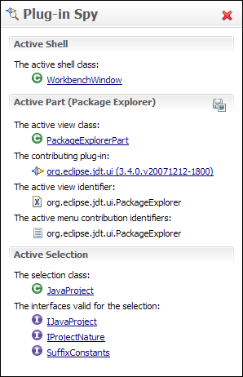
Plug-in Spy (3.4M3)
ALT+SHIFT+F1
Allows you to introspect what you’re looking at…
Hyperlinking
Shows contributing plug-ins
Eclipse Foundation, Inc.
What’s new for PDE in Ganymede? | © 2008 by Chris Aniszczyk; made available under the EPL v1.0

Slide 9
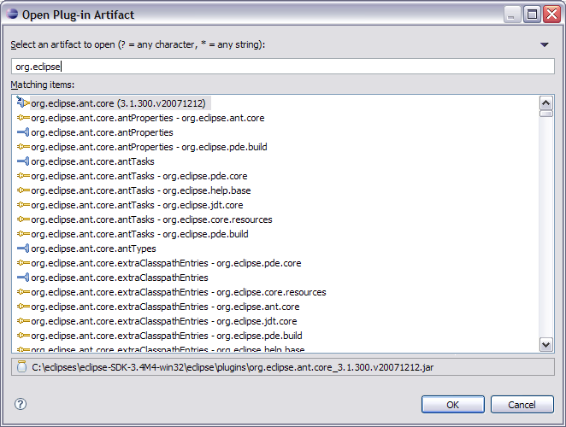
Open Plug-in Artifact (3.4M4)
Ctrl+Shift+A
Quickly browse plug-ins, extensions and extension points
Eclipse Foundation, Inc.
What’s new for PDE in Ganymede? | © 2008 by Chris Aniszczyk; made available under the EPL v1.0

Slide 10
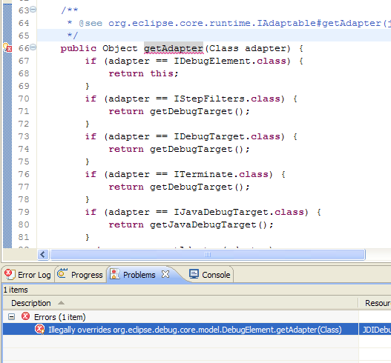
API Tooling (3.4M6)
API tooling will assist developers in API maintenance by reporting…
  API defects such as binary incompatibilities
  incorrect plug-in version numbers
  missing or incorrect @since tags
  usage of non-API code between plug-ins
Eclipse Foundation, Inc.
What’s new for PDE in Ganymede? | © 2008 by Chris Aniszczyk; made available under the EPL v1.0

Slide 11

Conclusion
http://www.eclipse.org/pde
Want to contribute?
  PDE Bug Day
  http://wiki.eclipse.org/BugDay
Thank you!
Eclipse Foundation, Inc.
What’s new for PDE in Ganymede? | © 2008 by Chris Aniszczyk; made available under the EPL v1.0

Slide 12
Questions?
Eclipse Foundation, Inc.
What’s new for PDE in Ganymede? | © 2008 by Chris Aniszczyk; made available under the EPL v1.0

